Slide 1
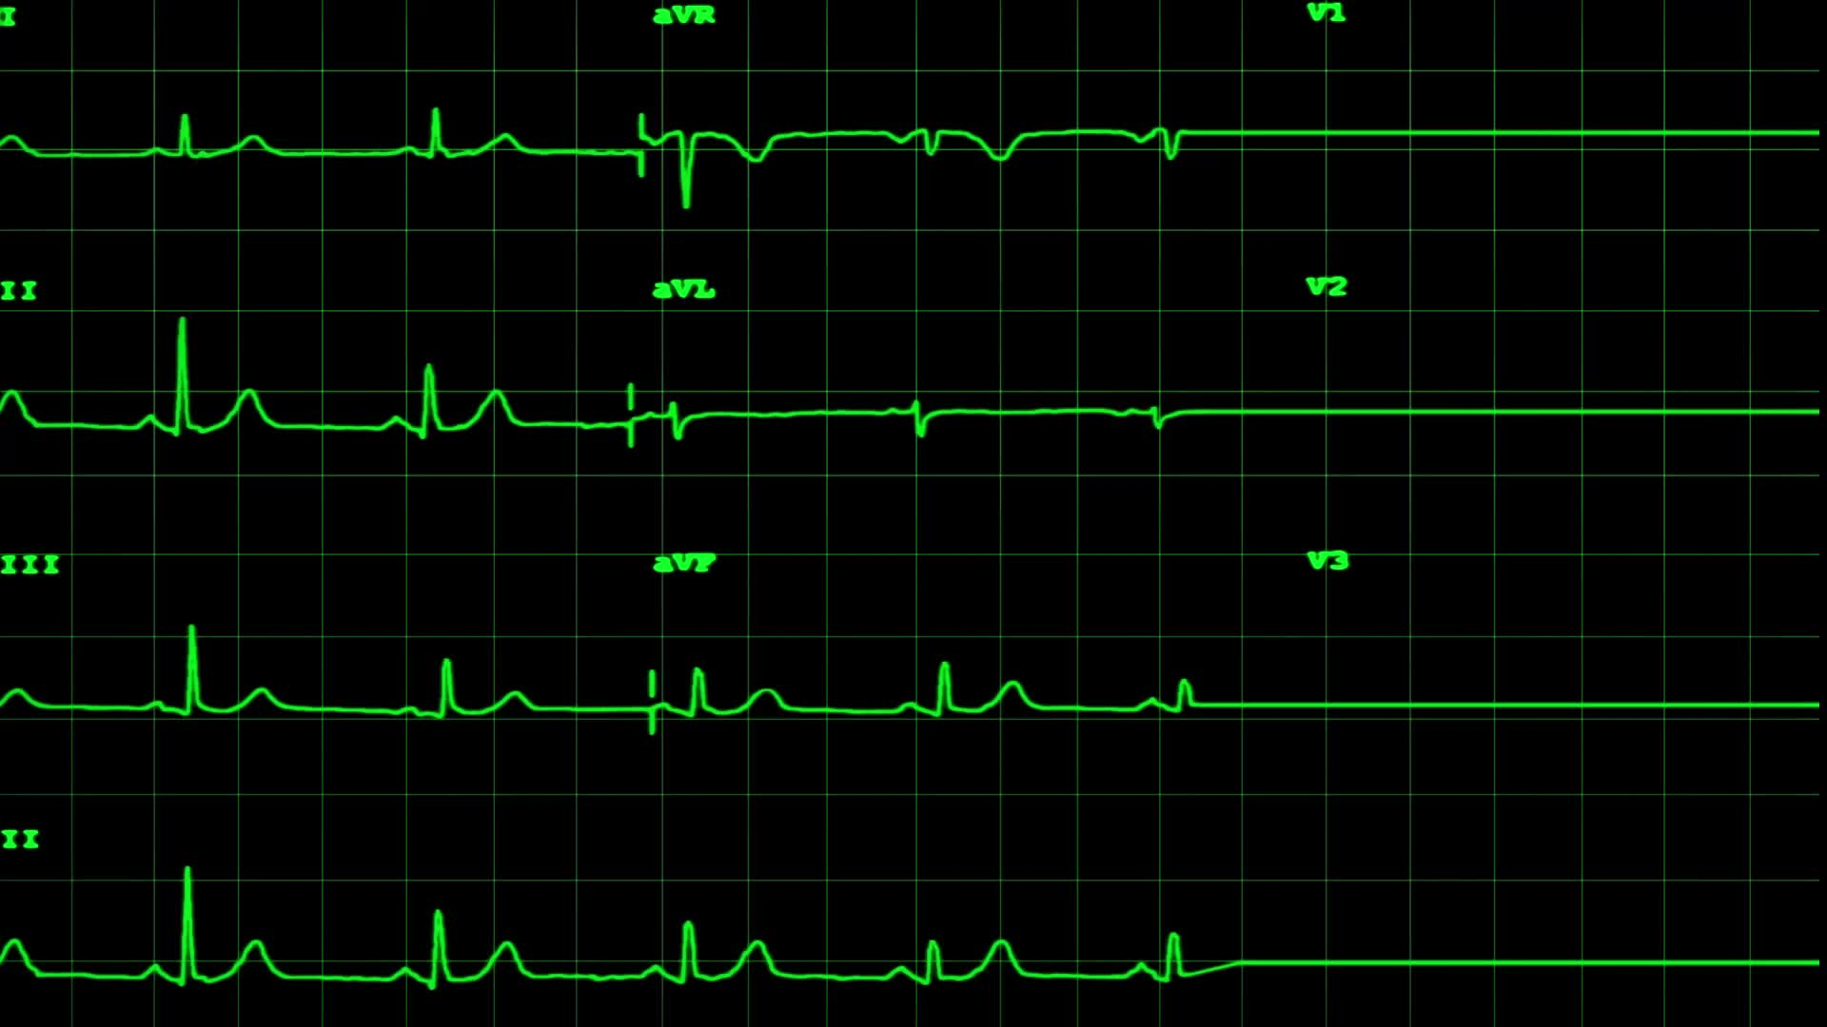
EXPLORATORY DATA ANALYSIS (EDA) ON HEART HEALTH DATASET

Slide 2
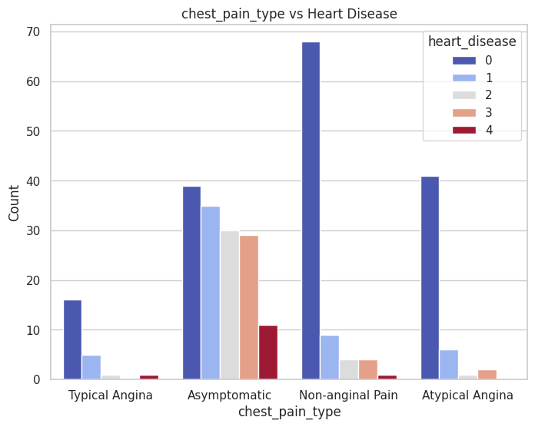
CHEST PAIN TYPE DISTIBUTION
Individuals without heart disease (heart_disease = 0) predominantly experience Asymptomatic and Non-anginal Pain types.

Slide 3
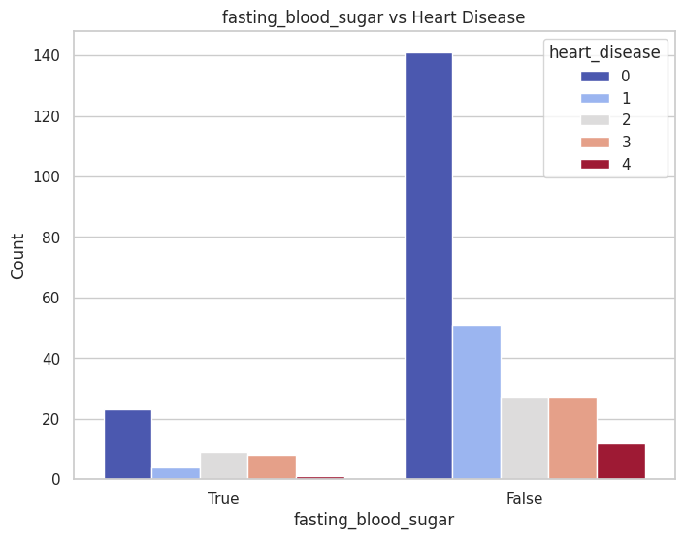
FASTING BLOOD SUGAR DISTRIBUTION
Individuals without heart disease (heart_disease = 0) generally have normal fasting blood sugar (False).
Elevated fasting blood sugar may serve as a potential risk factor for heart disease.

Slide 4
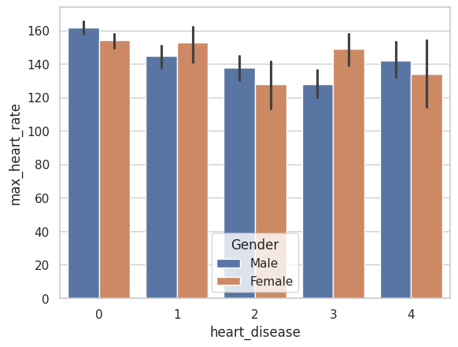
MAX HEART RATE BY DISEASE SEVERITY
Gender Trends Males generally exhibit higher maximum heart rates across all heart disease levels compared to females. Variability in heart rates within each severity level remains consistent across genders.

Slide 5
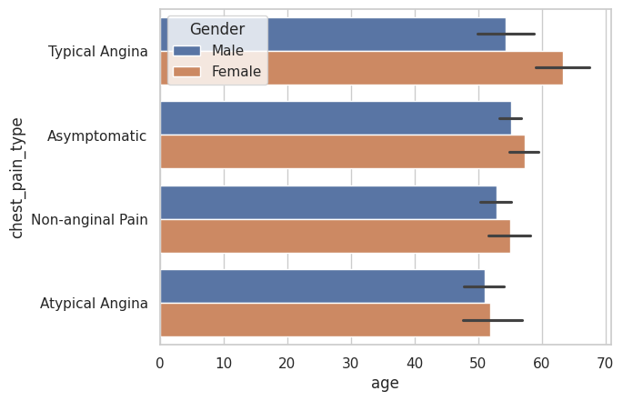
MAX HEART RATE BY DISEASE SEVERITY
Females show a higher prevalence of Typical Angina and Atypical Angina.
Males more commonly report Non-anginal Pain and Asymptomatic Pain.

Slide 6

Nottable Patterns
Gender Differences in Chest Pain Types
Key Observations: Males show a higher prevalence of Typical Angina and Atypical Angina.
Females more commonly report Non-anginal Pain and Asymptomatic Pain.
Insights:
Gender-specific patterns suggest differences in how men and women experience or report chest pain.
Age Influence on Chest Pain Types
Observations:
The average age for Typical Angina and Atypical Angina is higher compared to Non-anginal Pain and Asymptomatic Pain.
Older individuals are more likely to experience severe chest pain types.
Variability:
Error bars indicate overlapping age ranges across pain types, highlighting individual variability.

Slide 7

Summary
ECG Findings and Fasting Blood Sugar levels show potential as diagnostic tools for predicting heart disease risk.
Gender Differences: Males are more susceptible to severe heart disease, with specific patterns in chest pain types.
Chest Pain Types:
Typical Angina and Atypical Angina are associated with severe heart disease.
Non-anginal Pain and Asymptomatic Pain are more common in healthy individuals, particularly among females.
Max Heart Rate: Decreases with heart disease severity and shows gender-specific differences.

